Slide 1
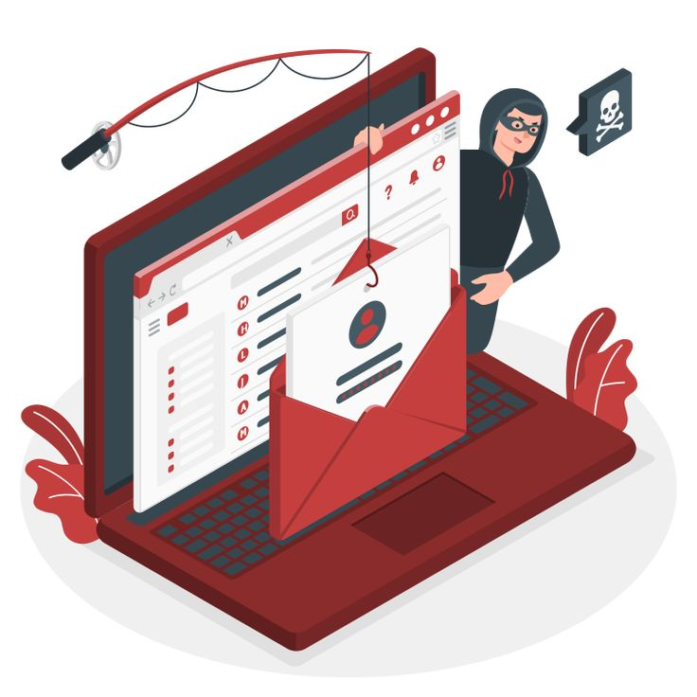
Phishing Attack Awareness

Slide 2
Content.
Overview and definition of terms.
Types of phishing attacks.
Recognizing phishing emails.
Prevention and avoidance.
Other social engineering tactics.
Conclusion.

Slide 3
What is a Phishing Attack?

Slide 4
Picture this: you get a message from your bank, your Internet Service Provider or a familiar company, asking you to confirm your account details, and ATM card PIN or click a link. It looks legitimate, right? But think - could it be a scam? This is called a Phishing attack.
A Phishing attack is a type of social engineering attack where attackers use deceptive emails, text messages, or websites to trick individuals into revealing sensitive information, such as passwords, credit card numbers, or other personal details. These attacks often come from trusted sources, like banks, or other well-known companies, making them even more convincing.
Some phishing emails may include malicious software that can monitor the activities of your computer system, cause harm to the system, or slow the computing speed of your system.

Slide 5
Types of Phishing Attacks.
Email Phishing: The most common form, where attackers send out mass emails pretending to be from trusted sources.
Spear Phishing: A more targeted one where the attacker customizes the phishing message for a specific individual or organization.
Whaling: This is a form of spear phishing targeting high-profile individuals, like executives, directors, or even politicians.
Smishing (SMS Phishing): This is an attempt made via SMS or text messages.
Vishing (Voice Phishing): This is conducted over the phone, where the attacker pretends to be a legitimate entity like a bank.

Slide 6
Identifying a Phishing Mail.
Urgency- A phishing attack will always have a sense of urgency, encouraging you to act quickly. E.g, “Please we will need your card details for verification else, your account might be shut down.
Suspicious link- A phishing message/ email might also include a link to a suspicious site, used by attackers to steal information
Unexpected attachments- A phishing email may include a file to be downloaded, many times this file will be used to cause harm to the victim’s system.
Generic greetings- Greetings such as “Dear customer”, or “Dear User” are often used in phishing attacks. This shows that the email has most likely been sent to many people.

Slide 7
Contd.
Poor grammar or spelling- Many phishing emails contain language errors that may be unnoticeable to the victims.
Unverified and unsecured links- Phishing links will often lack security certificates causing them to have a URL starting with “HTTP” instead of “HTTPS”.
Unusual requests- Requests such as giving account or card details will normally not be asked of any person because of security measures. But this will be asked in a phishing attack.

Slide 8
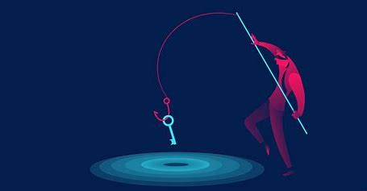
Some Phishing Attempts!

Slide 9
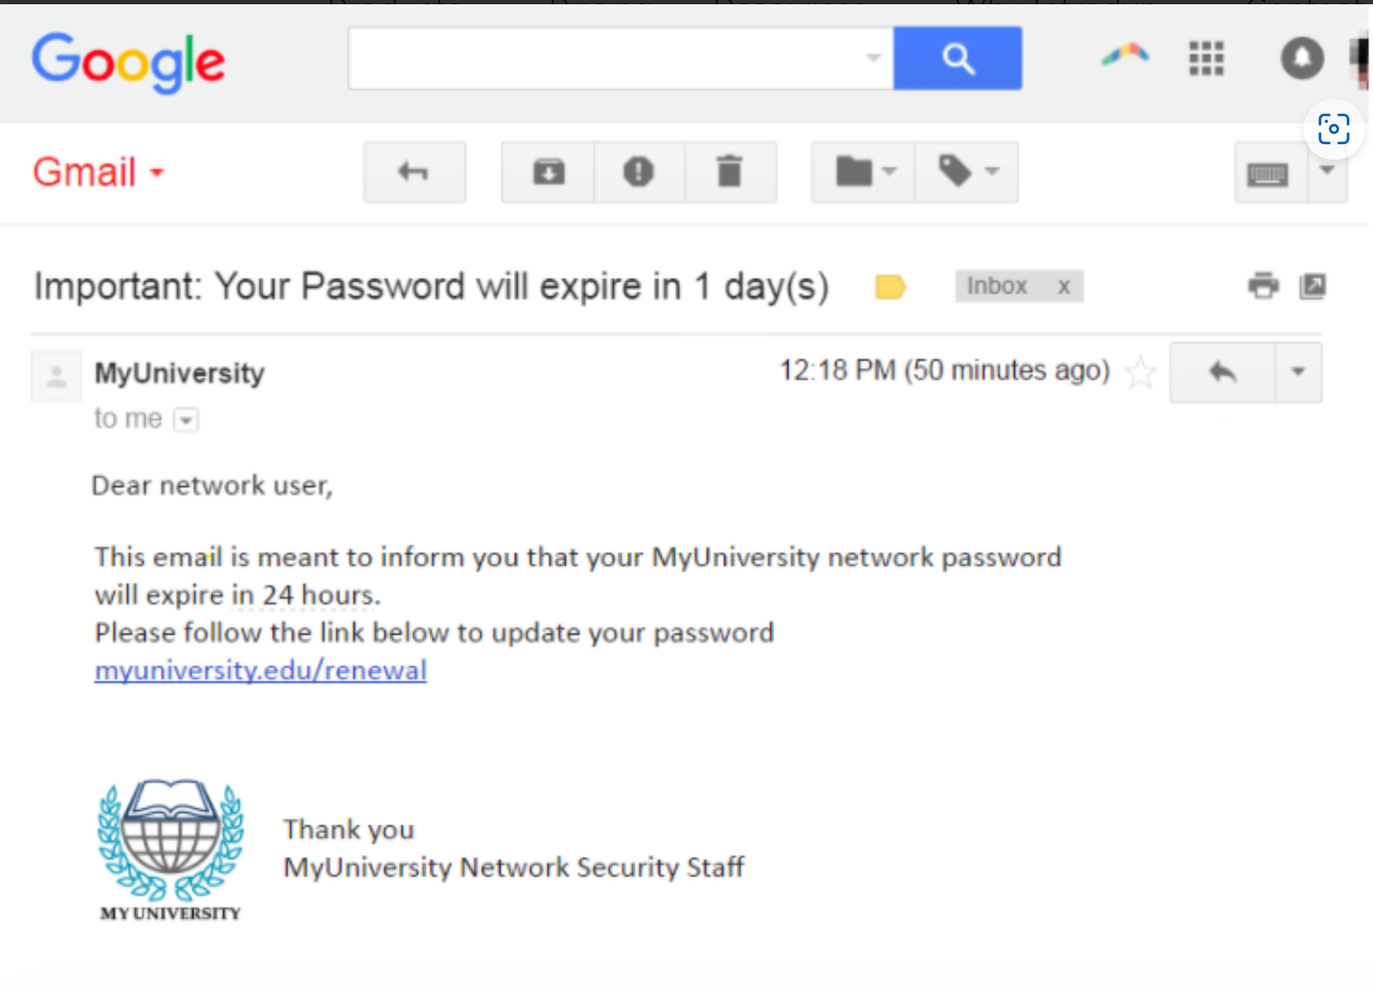
This email contains: Generic greeting. Sense of urgency. Suspicious link.

Slide 10
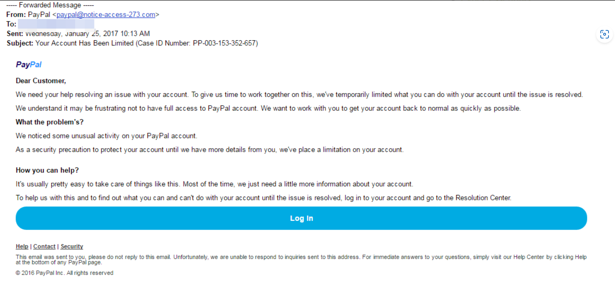
This email includes:
Generic greeting
Grammatical errors.
Asks user for login information.

Slide 11
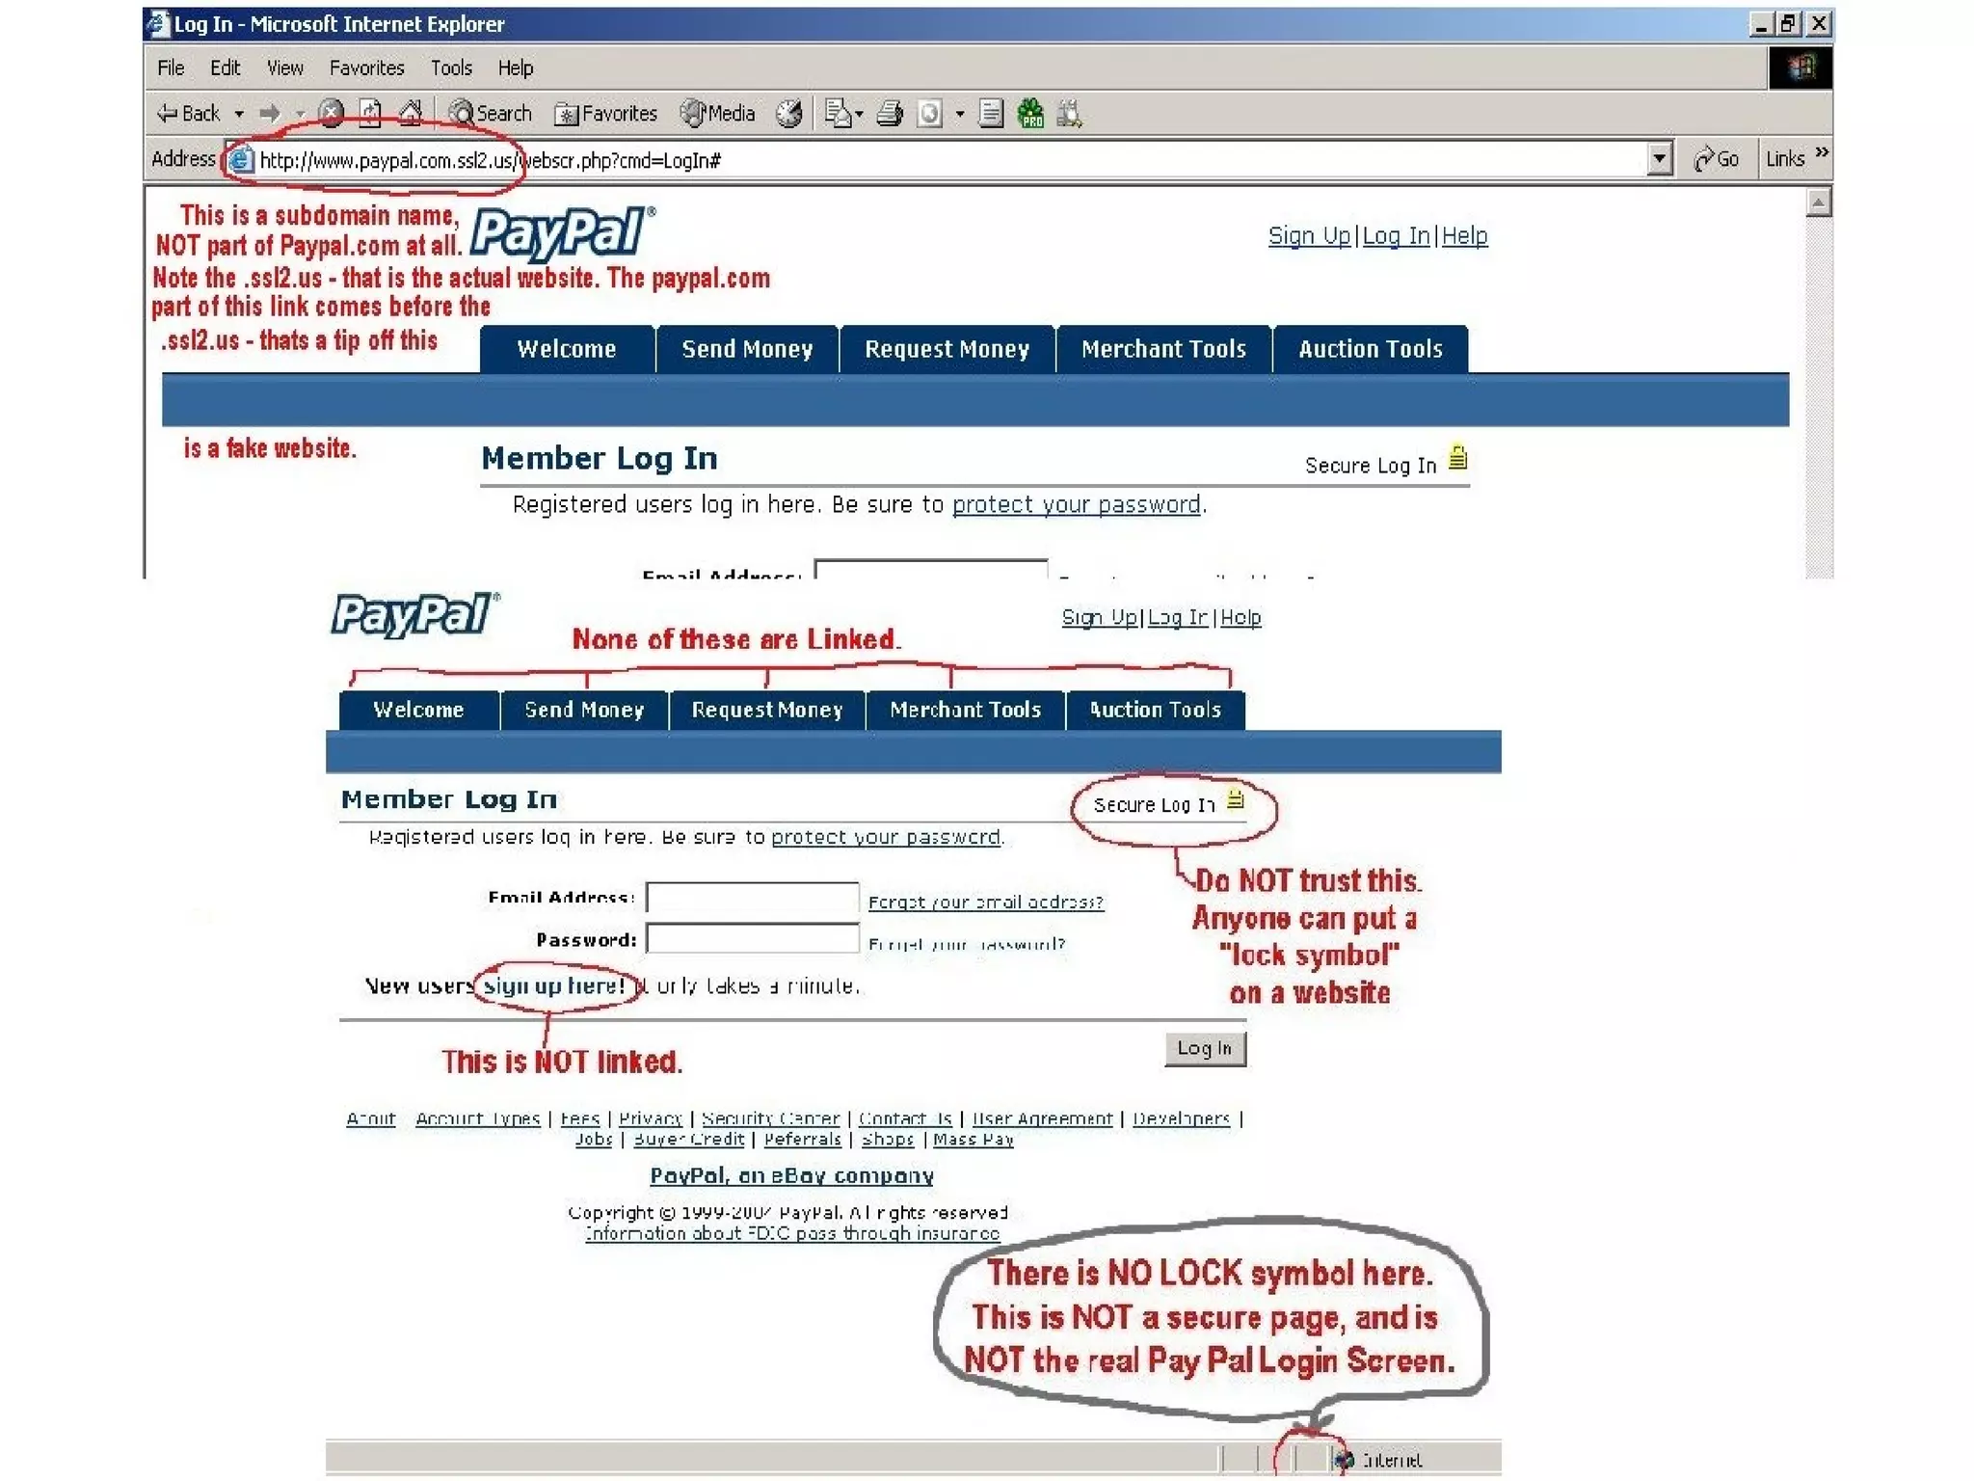

Slide 12
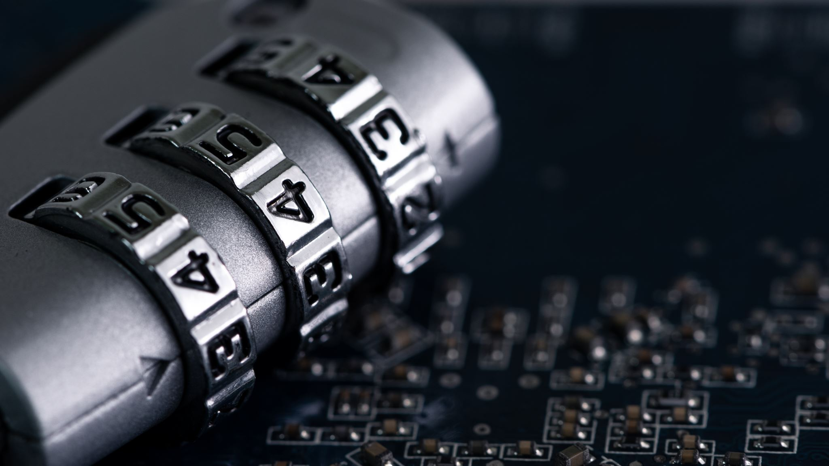
How to protect yourselves from Phishing Attacks.

Slide 13
Be Skeptical of Unexpected Emails and Messages. Be very cautious before you click whatever link you are sent. Remember- you can never be too careful!
Avoid Clicking on Suspicious Links- Before clicking, hover over the links to see the URL, some might be noticeably suspicious but some need extra attention.
Do Not Open Unexpected Attachments- To be safe, you can scan attachments for malware before opening them.
Multi-factor authentication adds an extra layer of security by requiring two or more forms of verification before you can access an account.
Educate Yourself and Others- Stay informed on all the popular phishing trends as it could happen to anybody.
Ensure your operating system, browsers, and security software are up to date. Regular updates help protect against vulnerabilities that could be exploited by phishing attacks.

Slide 14
Always remember: Phishing doesn’t discriminate, it only takes one convincing moment to catch anyone off guard Stay vigilant, stay protected!

Slide 15
Thank you

